Slide 1

UNIVERSITY OF MESSINA
Department
Cognitive Science and Theory of Communication – LM-55
Course Title
SOCIAL SEMIOTICS
Teacher
Maria Rita Bartolomei
Mail: mabartolomei@unime.it

Slide 2

SOCIAL SEMIOTICS
Sign
is the fundamental concept in semiotics
Semiotic resources
are the fundamental concept in social semiotics

Slide 3
SOCIAL SEMIOTICS
Semiotic resources are
Cultural resources – values, rites, norms, texts, songs or actions –
which lead to a common understanding
Cultural resources are useful
both
to produce communicative artefacts and events AND
to interpret them
in the context of specific social situations and practices

Slide 4
SOCIAL SEMIOTICS
Any semiotic resource – physical activity, object or artefact
has its own semiotic potential
Semiotic potential means the potential for making meaning
Each mode has its specific potential for making meaning
Each mode expresses meanings about states, relations, actions and events
in the world
Different modes offer different potentials for making meaning

Slide 5
SOCIAL SEMIOTICS
Semiotic resources
are not restricted to speech, writing and picture making: almost everything we do or make allows for the articulation of different social and cultural meanings
have specific forms in different cultures
The concept of “plural meanings” is crucial here

Slide 6
SOCIAL SEMIOTICS
Social semiotics
is a new and distinctive approach which
investigates how semiotic modes can be integrated in multimodal artefacts and events
investigates how these resources are used in specific historical, cultural and institutional contexts

Slide 7
SOCIAL SEMIOTICS
METAPHOR AND METONYMY
Metaphor
expresses the social nature of signification
is an explicit or implicit comparison
is a figure of speech which refers to one thing by mentioning another
is a type of figurative language
The original Greek word metaphora means “to transfer” or “carry over”.

Slide 8
SOCIAL SEMIOTICS
METAPHOR AND METONYMY
Metaphor
can have an interesting transference function
Tears Are Diamonds Falling From Your Eyes

Slide 9
SOCIAL SEMIOTICS
METAPHOR AND METONYMY
Metaphors
are an important literary device
represent abstract concepts through something common
All religions, arts and sciences are branches of the same tree
(Albert Einstein)
My heart is a bottomless ocean of love

Slide 10
SOCIAL SEMIOTICS
METAPHOR AND METONYMY
There are many types of metaphor
Implied metaphor
Jack tucked his tail and ran
Mary purred over the lavish present
At the party the men orbited around the super model
Dead metaphor
Throw the baby out with the bathwater
Heart of gold

Slide 11
SOCIAL SEMIOTICS
METAPHOR AND METONYMY
Mixed metaphor
We were flying through a sea of success
You're sailing close to thin ice
Metaphor one: you are sailing too close to the wind
Metaphor two: you are on thin ice
The test is easy; it’s not rocket surgery
Metaphor one: It's not rocket science
Metaphor two: It's not brain surgery.

Slide 12
SOCIAL SEMIOTICS
METAPHOR AND METONYMY
Sustained or extended metaphor
is carried through multiple sentences or even paragraphs
A famous example in English literature comes from All the world’s stage by William Shakespeare
Here Shakespeare uses the “stage” as an extended metaphor.

Slide 13
SOCIAL SEMIOTICS
All the world’s stage, by William Shakespeare (monologue from As You Like It)
All the world’s a stage,
And all the men and women merely players;
They have their exits and their entrances;
And one man in his time plays many parts,
His acts being seven ages. At first the infant,
Mewling and puking in the nurse’s arms;
And then the whining school-boy, with his satchel
And shining morning face, creeping like snail
Unwillingly to school. And then the lover,
Sighing like furnace, with a woeful ballad
Made to his mistress’ eyebrow. Then a soldier,
Full of strange oaths, and bearded like the pard,
Jealous in honour, sudden and quick in quarrel,

Slide 14
SOCIAL SEMIOTICS
Seeking the bubble reputation
Even in the cannon’s mouth. And then the justice,
In fair round belly with good capon lin’d,
With eyes severe and beard of formal cut,
Full of wise saws and modern instances;
And so he plays his part. The sixth age shifts
Into the lean and slipper’d pantaloon,
With spectacles on nose and pouch on side;
His youthful hose, well sav’d, a world too wide
For his shrunk shank; and his big manly voice,
Turning again toward childish treble, pipes
And whistles in his sound. Last scene of all,
That ends this strange eventful history,
Is second childishness and mere oblivion;
Sans teeth, sans eyes, sans taste, sans everything.

Slide 15
SOCIAL SEMIOTICS
METAPHOR AND METONYMY
Metaphor
Metaphor can be visual, verbal or multimodal
Visual metaphor
a representation of a noun through a visual image which suggests
a particular association or similarity
Visual metaphors are important in communicating and resonating
with your audience

Slide 16
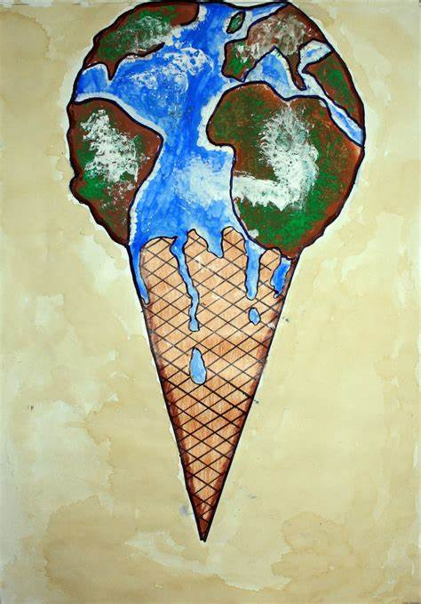

SOCIAL SEMIOTICS
METAPHOR AND METONYMY
Visual metaphor

Slide 17
SOCIAL SEMIOTICS
METAPHOR AND METONYMY
What is the difference between a metaphor and a simile?
A metaphor states that one thing IS something else
Example: that test was a killer
A simile states that one thing is LIKE something else
Example: my cousin is like an open book

Slide 18
SOCIAL SEMIOTICS
METAPHOR AND METONYMY
Metonymy
is a process, a general process of association of terms
a type of connotation in which one sign replaces another with
which it is closely associated
the sign used may represent a part, the whole, a function, an attribute
or a concept related to the sign represented

Slide 19
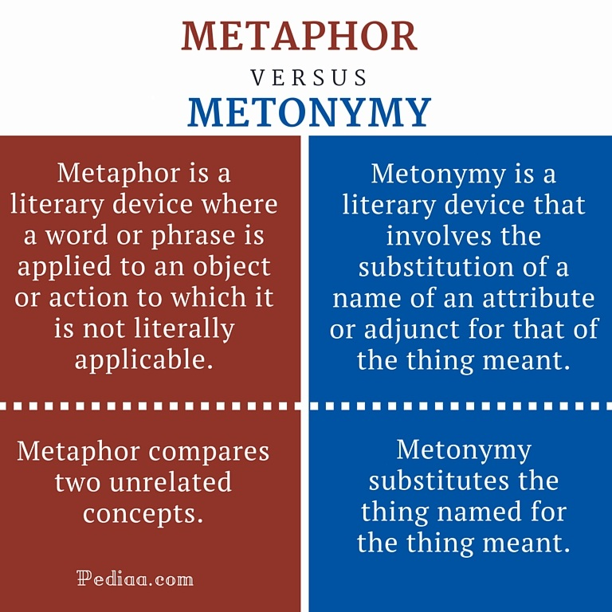
SOCIAL SEMIOTICS

Slide 20
SOCIAL SEMIOTICS
METAPHOR AND METONYMY
Examples work metonymically
Stereotypes are metonymies
Visual metonymy is also common

Slide 21

SOCIAL SEMIOTICS
METAPHOR AND METONYMY

Slide 22


SOCIAL SEMIOTICS

Slide 23

SOCIAL SEMIOTICS

Slide 24



SOCIAL SEMIOTICS
METAPHOR AND METONYMY
Metonymies can be quite complex chains of associations

Slide 25


SOCIAL SEMIOTICS
METAPHOR AND METONYMY

Slide 26
SOCIAL SEMIOTICS
METAPHOR AND METONYMY
Metonymy is often powerfully invoked in political discourse

Slide 27

SOCIAL SEMIOTICS

Slide 28
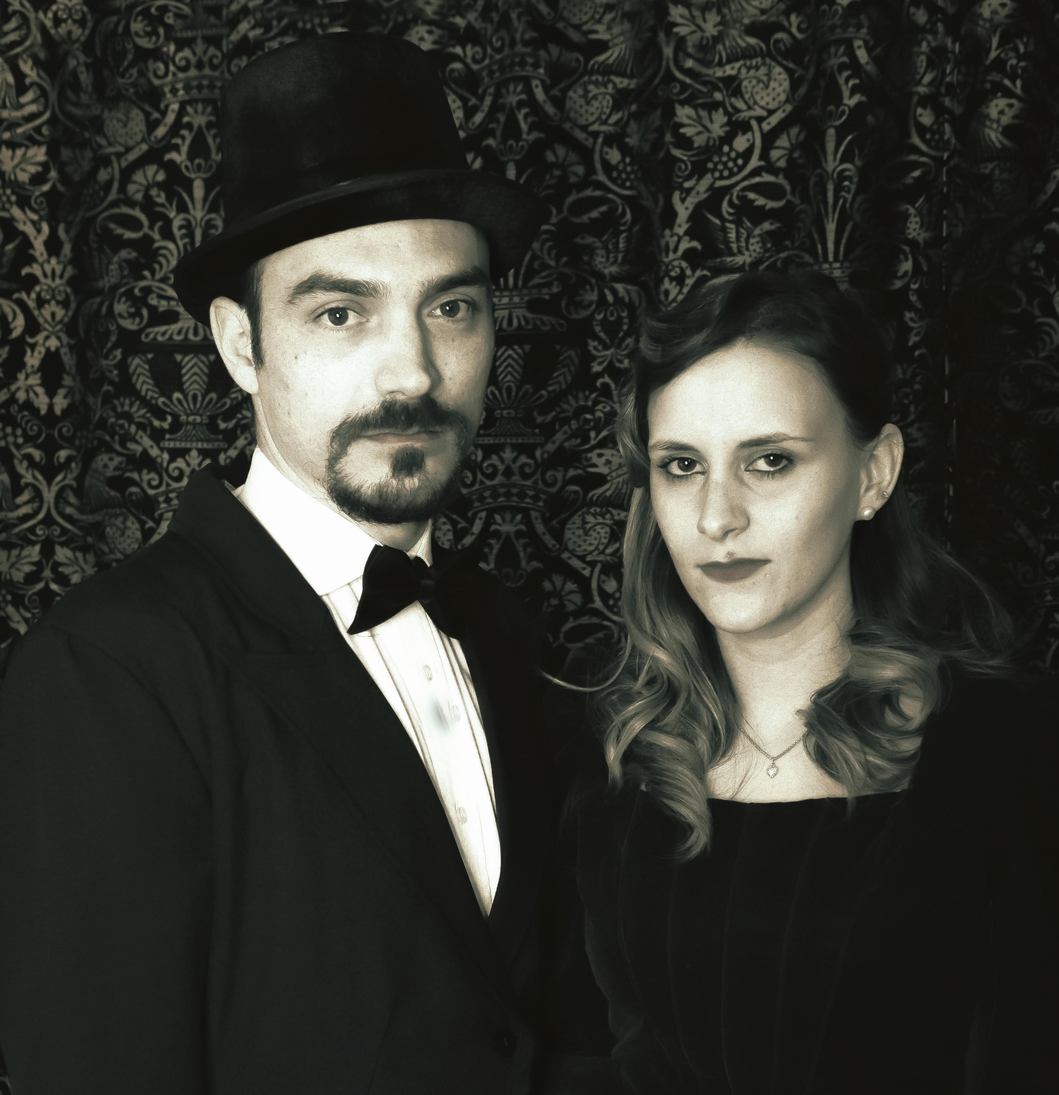
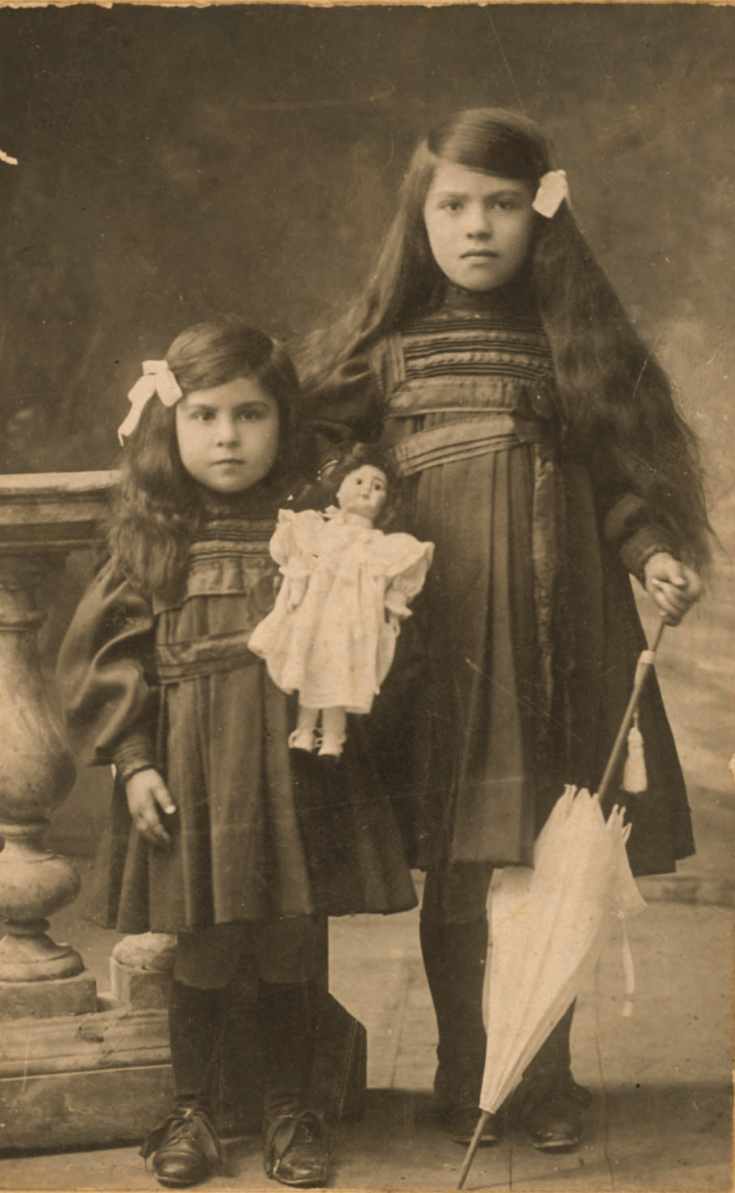
SOCIAL SEMIOTICS

Slide 29

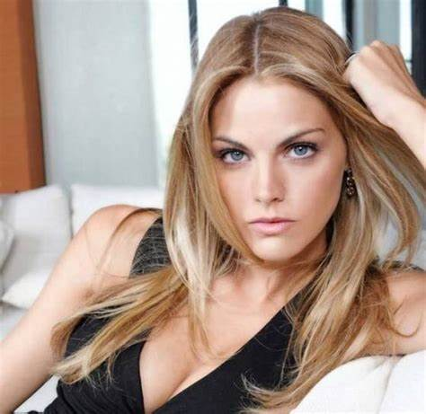
SOCIAL SEMIOTICS

Slide 30
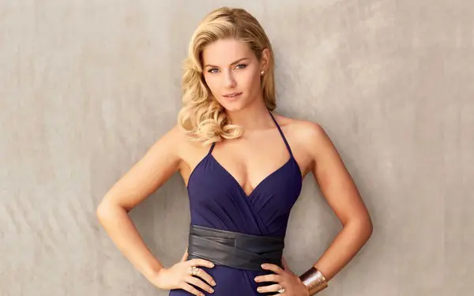

SOCIAL SEMIOTICS
e

Slide 31

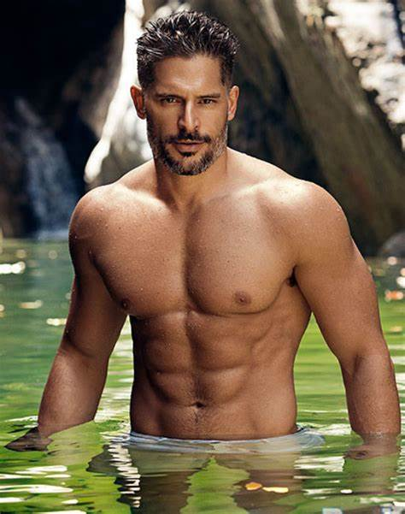
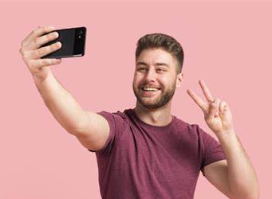
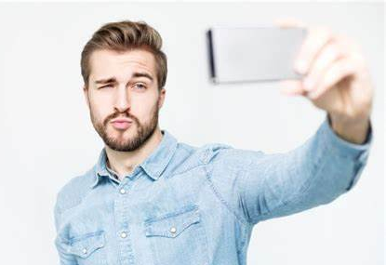
SOCIAL SEMIOTICS
e

Slide 32
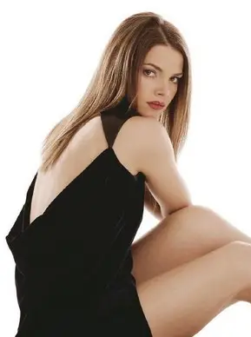
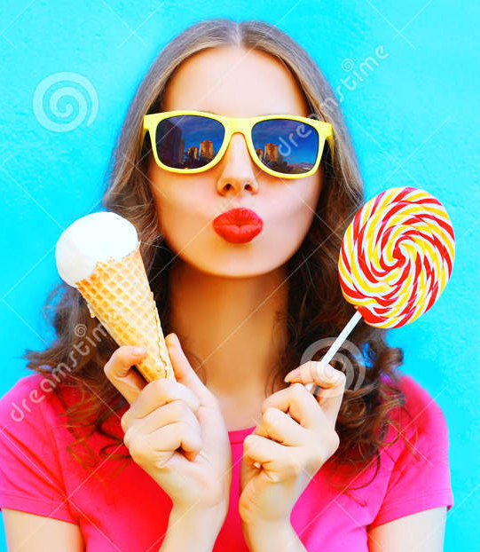
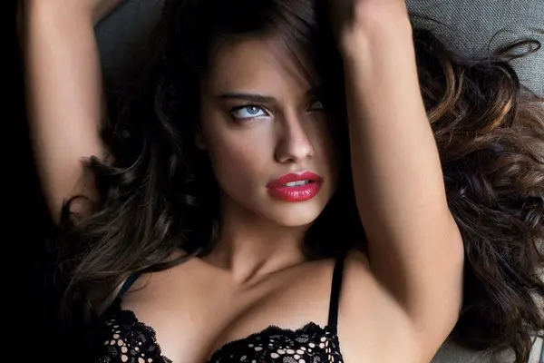
SOCIAL SEMIOTICS
e

Slide 33
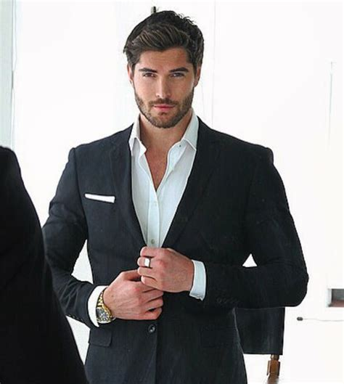
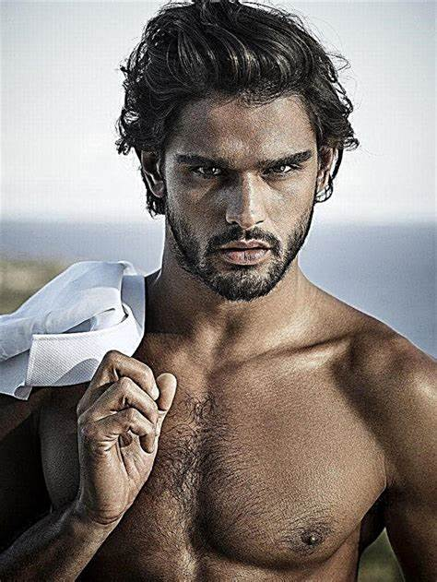
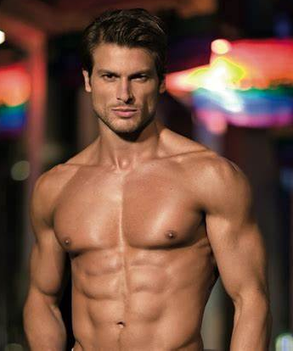
SOCIAL SEMIOTICS
e

Slide 34
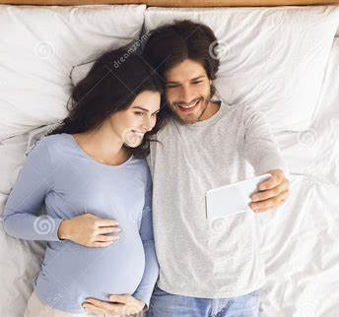

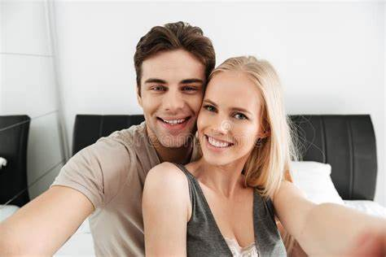

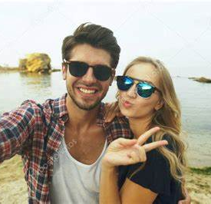
SOCIAL SEMIOTICS

Slide 35
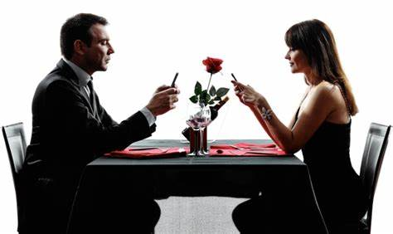
SOCIAL SEMIOTICS

